Slide 1
Forms

Slide 2
Forms
Forms make a person to view the document with dynamic information.
Also obtain information from the person viewing it, and process the information.

Slide 3
Forms
To insert a form we use the <FORM></FORM> tags. The rest of the form elements must be inserted in between the form tags.
<HTML>
<HEAD><TITLE> Sample Form</TITLE></HEAD>
<BODY BGCOLOR=“red”>
  <FORM ACTION = http://www.xnu.com/formtest.asp>
  <P> First Name: <INPUT TYPE=“TEXT” NAME=“fname”> </P>
  <P><INPUT TYPE=“SUBMIT” NAME=“sub1” VALUE=“Send Info”> </P>
  </FORM>
</BODY>
</HTML>

Slide 4
<FORM> element attributes
ACTION: is the URL of the CGI (Common Gateway Interface) program that is going to accept the data from the form, process it, and send a response back to the browser.
METHOD: GET (default) or POST specifies which method will be used to send the form’s contents to the web server.
NAME: is a form name used by VBScript or JavaScripts.
TARGET: is the target frame where the response page will show up.
Notes:
The common gateway interface (CGI) is a standard way for a Web server to pass a Web user's request to an application program and to receive data back to forward to the user.

Slide 5
Form Elements
Form elements have properties: Text boxes, Password boxes, Checkboxes, Option(Radio) buttons, Submit, Reset, File and Image.
The properties are specified in the TYPE Attribute of the HTML element <INPUT></INPUT>.

Slide 6
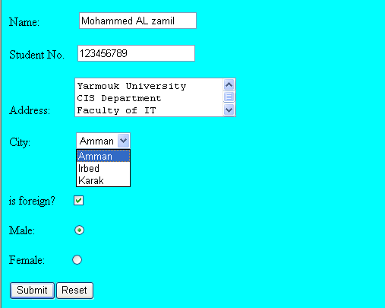
Sami Ali
Al al-Bayt University

Slide 7
Form Elements
<INPUT> Element’s Properties
TYPE= Type of INPUT entry field.
NAME = Variable name passed to CGI application
VALUE= The data associated with the element to be passed to the CGI application
CHECKED= Button/box checked
SIZE= Number of visible characters in text field
MAXLENGTH= Maximum number of characters accepted.

Slide 8

Text Box
Text boxes: Used to provide input fields for text, phone numbers, dates, etc.
<INPUT TYPE= " TEXT " >
Browser will display
Textboxes use the following attributes:
  TYPE: text.
  SIZE: determines the size of the textbox in characters. Default=20 characters.
  MAXLENGTH : determines the maximum number of characters that the field will accept.
  NAME: is the name of the variable to be sent to the CGI application.
  VALUE: will display its contents as the default value.
  READONLY: the value cannot be changed
  DISABLED: the user can’t do anything with this element

Slide 9
Autocomplete: Sets or returns the value of the autocomplete attribute of a text field.
Autofocus: Sets or returns whether a text field should automatically get focus when the page loads.
Pattern: Sets or returns the value of the pattern attribute of a text field "[0-9]“, {10}.
Required: Sets or returns whether the text field must be filled out before submitting a form

Slide 10
Example on Text Box
<HTML>
<HEAD>
<TITLE>Form_Text_Type</TITLE>
</HEAD>
<BODY>
<h1> <font color=blue>Please enter the following bioData</font></h1>
<FORM name="fome1" Method= "get" Action= "URL " >
First Name: <INPUT TYPE="TEXT" NAME="FName“ SIZE="15" MAXLENGTH="25"><BR>
  Last Name: <INPUT TYPE="TEXT" NAME="LName“ SIZE="15" MAXLENGTH="25"><BR>
  National: <INPUT TYPE="TEXT" NAME="Country“ SIZE="25" MAXLENGTH="25"><BR>
  Contact: <INPUT TYPE="TEXT" NAME="Phone“ SIZE="15" MAXLENGTH="12"><BR>
</FORM>
</BODY>
</HTML>

Slide 11
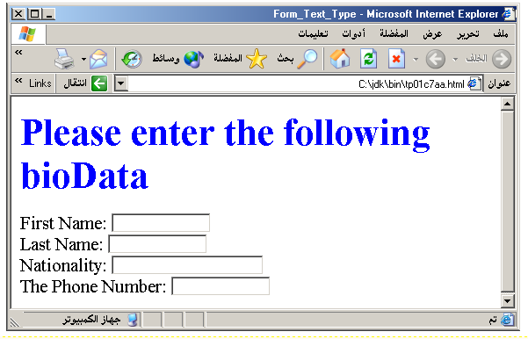
Output

Slide 12
Password
Password: Used to allow entry of passwords.
<INPUT TYPE= " PASSWORD " >
Browser will display
Text typed in a password box is starred out in the browser display.
Password boxes use the following attributes:
  TYPE: password.
  SIZE: determines the size of the textbox in characters.
  MAXLENGHT: determines the maximum size of the password in characters.
  NAME: is the name of the variable to be sent to the CGI application.
  VALUE: is usually blank.

Slide 13
Example on Password Box
<HTML>
<HEAD><TITLE>Form_Password</TITLE> </HEAD>
<BODY>
<h1> <font color=red>To Access, Please
enter:</font></h1>
<FORM name="fome2" Action="url" method="get">
  User Name: <INPUT TYPE="TEXT" Name="Fname" SIZE="15" MAXLENGTH="25"><BR>
  Password: <INPUT TYPE="PASSWORD" NAME="PWord" value=" " SIZE="15" MAXLENGTH="25"><BR>
</FORM></BODY> </HTML>

Slide 14
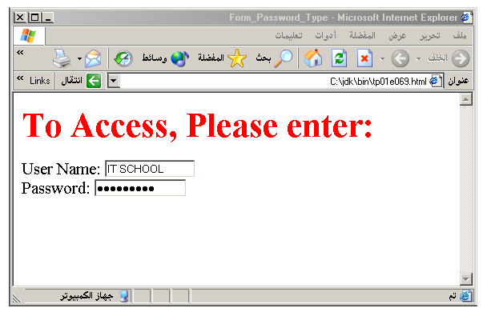
Output

Slide 15
Hidden
Hidden: Used to send data to the CGI application that you don’t want the web surfer to see, change or have to enter but is necessary for the application to process the form correctly.
<INPUT TYPE=“HIDDEN”>
Nothing is displayed in the browser.
Hidden inputs have the following attributes:
TYPE: hidden.
NAME: is the name of the variable to be sent to the CGI application.
VALUE: is usually set a value expected by the CGI application.

Slide 16
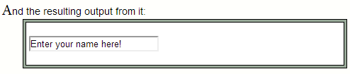
Example:
<html>
<head><title>My Page</title></head>
<form name="myform" action="http://www.mydomain.com/myformhandler.cgi" method="POST">
<input type="text" size="25" value="Enter your name here!">
<input type="hidden" name="Language" value="English">
</form>
</html>
Note: The hidden field does not show, but still, when the form is submitted the hidden field is sent with it. In this example the hidden field would tell the program that handles the form, that the users preferred language is English.

Slide 17
Check Box
Check Box: Check boxes allow the users to select more than one option.
<INPUT TYPE=“CHECKBOX”>
Browser will display
Checkboxes have the following attributes:
  TYPE: checkbox.
  CHECKED: is blank or CHECKED as the initial status.
  NAME: is the name of the variable to be sent to the CGI application.
  VALUE: is usually set to a value.
  Autofocus: Sets or returns whether a checkbox should automatically get focus when the page loads.
  Required: Sets or returns whether the checkbox must be checked before submitting a form

Slide 18
<HTML>
<HEAD><TITLE>CheckBoxType</TITLE> </HEAD>
<BODY>
<h1> <font color=green>Please check one of the following</font></h1>
<FORM name="fome3" Action="url" method="get">
  <font color=red> Select Country: </font><BR>
  jordan:<INPUT TYPE="CheckBox" Name="country" value= " Jordan " CHECKED><BR>
  Yemen<INPUT TYPE="CheckBox" Name="country " value= " Yemen " <BR>
  Qatar:<INPUT TYPE="CheckBox " Name="country " value= " Qatar " > <BR> <BR>
  <font color=blue>Select Language:</font><BR>
  Arabic:<INPUT TYPE="CheckBox" Name="lang" Value= " Arabic " CHECKED><BR>
  English:<INPUT TYPE="CheckBox" Name="lang " Value= " English " ><BR>
  French:<INPUT TYPE="CheckBox" Name="lang " Value= " French" ><BR>
  </FORM>
  </BODY></HTML>

Slide 19
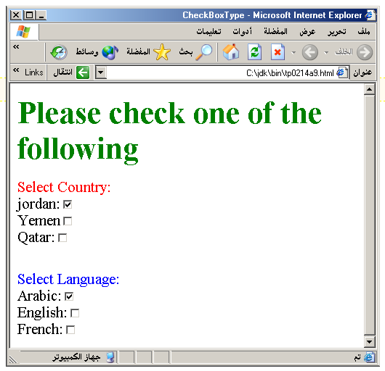
Output

Slide 20
Radio Button
Radio Button: Radio buttons allow the users to select only one option.
<INPUT TYPE=“RADIO”>
Browser will display
Radio buttons have the following attributes:
  TYPE: radio.
  CHECKED: is blank or CHECKED as the initial status. Only one radio button can be checked
  NAME: is the name of the variable to be sent to the CGI application.
  VALUE: usually has a set value.
  Autofocus: Sets or returns whether a checkbox should automatically get focus when the page loads.
  Required: Sets or returns whether the checkbox must be checked before submitting a form.

Slide 21
<HTML>
<HEAD><TITLE>CheckBoxType</TITLE> </HEAD>
<BODY>
<h1> <font color=green>Please check one of the following</font></h1>
<FORM name="form3" Action="url" method="get">
  <font color=red> Select Country: </font><BR>
  jordan:<INPUT TYPE= " Radio" Name="country" value= " Jordan " CHECKED><BR>
  Yemen<INPUT TYPE= " Radio" Name="country " value= " Yemen " <BR>
  Qatar:<INPUT TYPE= " Radio" Name="country " value= " Qatar " > <BR> <BR>
  <font color=blue>Select Language:</font><BR>
  Arabic:<INPUT TYPE= " Radio" Name="lang" Value= " Arabic " CHECKED><BR>
  English:<INPUT TYPE= " Radio" Name="lang " Value= " English " ><BR>
  French:<INPUT TYPE= " Radio" Name="lang " Value= " French" >
  </FORM>
  </BODY></HTML>

Slide 22
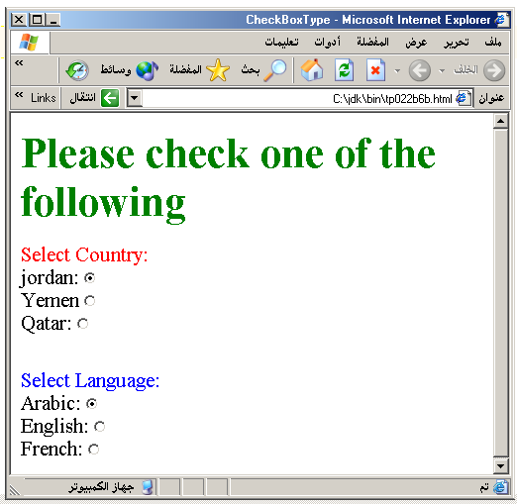

Slide 23
<fieldset> <fieldset>
<form>
<fieldset>
<legend align="right">Personal Information</legend>
Name: <input type="text" size="30"><br>
Email: <input type="text" size="30"><br>
Date of birth: <input type="text" size="10">
</fieldset>

Slide 24
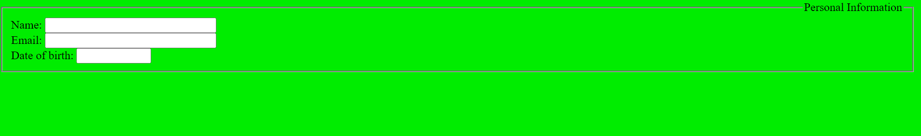

Slide 25
Push Button
Push Button: This element would be used with JavaScript to cause an action to take place.
<INPUT TYPE=“BUTTON”>
Browser will display
Push Button has the following attributes:
  TYPE: button.
  NAME: is the name of the button to be used in scripting.
  VALUE: determines the text label on the button.
  Autofocus: Sets or returns whether an input button should automatically get focus when the page loads.
  Disabled: Sets or returns whether an input button is disabled, or not.

Slide 26
<FORM>
  <FONT Color=red>
  <h1>Press Here to see a baby crying:<BR>
  <INPUT TYPE="button" VALUE="PressMe"><BR><BR>
  <FONT Color=blue>
  Click Here to see a baby shouting:<BR>
  <INPUT TYPE="button" VALUE="ClickMe" > <BR><BR>
  <FONT Color=green>
  Hit Here to see a baby eating:<BR>
  <INPUT TYPE="button" VALUE="HitME" > <BR><BR>
</FORM>

Slide 27
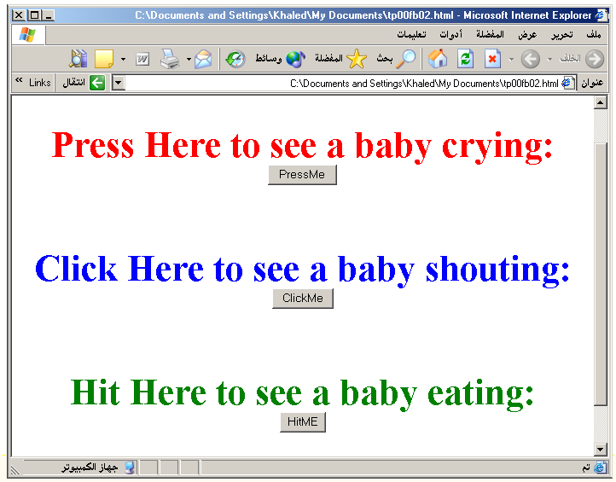

Slide 28
Submit Button
Submit: Every set of Form tags requires a Submit button. This is the element causes the browser to send the names and values of the other elements to the CGI Application specified by the ACTION attribute of the FORM element.
<INPUT TYPE=“SUBMIT”>
The browser will display
Submit has the following attributes:
  TYPE: submit.
  NAME: value used by the CGI script for processing.
  VALUE: determines the text label on the button, usually Submit Query.
  formNoValidate: Sets or returns whether the form-data should be validated or not, on submission.
  formTarget: Sets or returns the value of the formtarget attribute of a submit button

Slide 29
HTML <form> target Attribute Values
Value | Description
_blank | The response is displayed in a new window or tab
_self | The response is displayed in the same frame (this is default)
_parent | The response is displayed in the parent frame
_top | The response is displayed in the full body of the window
framename | The response is displayed in a named iframe

Slide 30
<FORM Action="URL" method="get">
  First Name: <INPUT TYPE="TEXT" Size=25 Name="firstName"><BR>
  Last Name: <INPUT TYPE="TEXT" Size=25 ame="LastName"><BR>
  <BR>
  <FONT Color=red>Press Here to submit the data:<BR>
  <INPUT TYPE="submit" VALUE="SubmitData " >
</FORM>

Slide 31
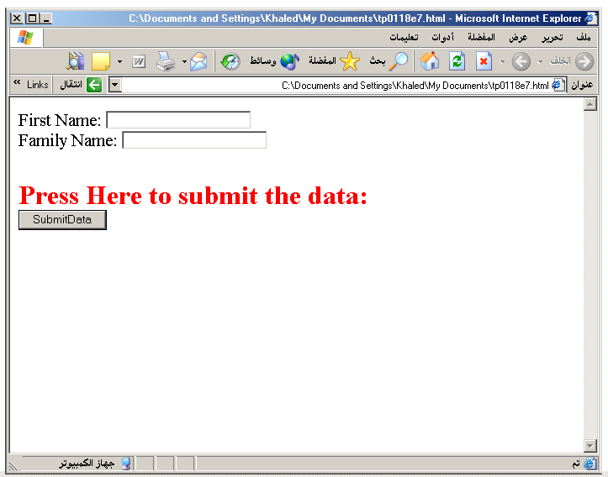

Slide 32
Reset Button
Reset: It is a good idea to include one of these for each form where users are entering data. It allows the browser to clear all the inserted values in various input properties in the form.
<INPUT TYPE=“RESET”>
Browser will display
Reset buttons have the following attributes:
  TYPE: reset.
  VALUE: determines the text label on the button, usually Reset.
  Disabled: Sets or returns the default value of a reset button
  Autofocus: Sets or returns whether a reset button should automatically get focus when the page loads

Slide 33
<FORM Action="URL" method="get">
  First Name: <INPUT TYPE="TEXT" Size=25 name="firstName"> <BR>
  Last Name: <INPUT TYPE="TEXT" Size=25 name="LastName"><BR>
  <BR>
  <FONT Color = red>
  <STRONG>
  <font size=5>Press Here to submit the data:</font>
  </STRONG> <BR>
  <INPUT TYPE="submit" VALUE="SubmitData">
  <INPUT TYPE="RESET" VALUE="Reset">
</FORM>

Slide 34
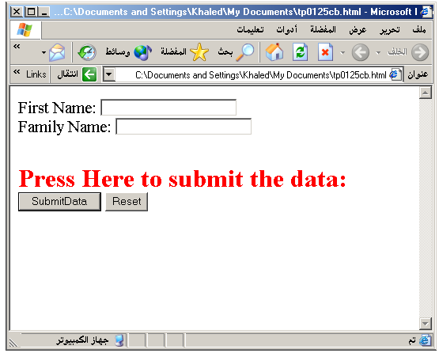

Slide 35
Image Submit Button
Image Submit Button: Allows you to substitute an image for the standard submit button.
<INPUT TYPE=“IMAGE” SRC=“jordan.gif”>
Image submit button has the following attributes:
  TYPE: Image.
  NAME: is the name of the button to be used in scripting.
  SRC: URL of the Image file.
  Disabled: Sets or returns the default value of a reset button
  Autofocus: Sets or returns whether a reset button should automatically get focus when the page loads.
  Height: Sets or returns the value of the height attribute of the input image.
  Width: Sets or returns the value of the width attribute of the input image

Slide 36
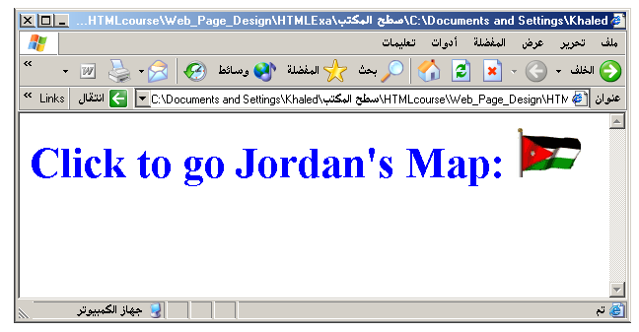
<form>
<h1><font color=blue></h1>
Click to go Jordan’s Map:
<INPUT TYPE="IMAGE" SRC="jordan.gif">
</form>

Slide 37

File
File Upload: You can use a file upload to allow surfers to upload files to your web server.
<INPUT TYPE=“FILE”>
File Upload has the following attributes:
TYPE: file.
SIZE: is the size of the text box in characters.
NAME: is the name of the variable to be sent to the CGI application.
MAXLENGHT: is the maximum size of the input in the textbox in characters.

Slide 38
Autofocus: Sets or returns whether a file upload button should automatically get focus upon page load.
Multiple: Sets or returns whether a user is allowed to select more than one file in the file upload field.
Required: Sets or returns whether a file in the file upload field must be selected before submitting a form

Slide 39
<BODY bgcolor=lightblue>
<form>
<H3><font color=forestgreen>
Please attach your file here to for uploading to</H3>
My <font color =red>SERVER...<BR>
<INPUT TYPE="File" name="myFile" size="30">
<INPUT TYPE="Submit" value="SubmitFile">
</form>
</BODY>

Slide 40
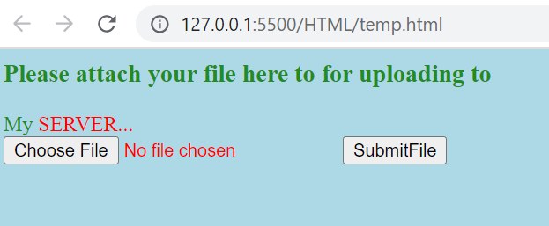

Slide 41
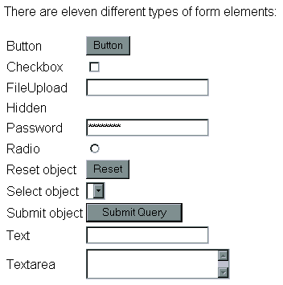

Slide 42
Number(5)
The <input type="number"> is used for input fields that should contain a numeric value.
Attributes:-
Disabled: Specifies that an input field should be disabled.
Max: Specifies the maximum value for an input field.
Min: Specifies the minimum value for an input field.
Pattern: Specifies a regular expression to check the input value against.
Required: Specifies that an input field is required (must be filled out).
Step: Specifies the legal number intervals for an input field

Slide 43
<form action="action_page.php">
Quantity (between 1 and 5):
<input type="number" name="quantity" min="1" max="5">
<input type="submit">
</form>
<form action="action_page.php">
Quantity:
<input type="number" name="points"
min="0" max="100" step="10" value="30">
<input type="submit">
</form>

Slide 44
Date
The <input type="date"> is used for input fields that should contain a date.
Attributes:
defaultValue: Sets or returns the default value of a date field.
Max: Sets or returns the value of the max attribute of the date field.
Min: Sets or returns the value of the min attribute of the date field.
Step: Sets or returns the value of the step attribute of the date field

Slide 45
<form>
Birthday:
<input type="date" name="bday">
</form>
<form>
Enter a date before 1980-01-01:
<input type="date" name="bday" max="1979-12-31"><br>
Enter a date after 2000-01-01:
<input type="date" name="bday" min="2000-01-02"><br>
</form>

Slide 46
Email
The <input type="email"> is used for input fields that should contain an e-mail address.
Attributes:
Autocomplete: Sets or returns the value of the autocomplete attribute of an email field.
Autofocus: Sets or returns whether an email field should automatically get focus when the page loads.
Multiple: Sets or returns whether a user is allowed to enter more than one email address in the email field.
Required: Sets or returns whether the email field must be filled out before submitting a form

Slide 47
<form action="action_page.php">
E-mail:
<input type="email" name="email" multiple>
<input type="submit">
</form>

Slide 48
Datalist
The <datalist> tag specifies a list of pre-defined options for an <input> element.
The <datalist> tag is used to provide an "autocomplete" feature on <input> elements. Users will see a drop-down list of pre-defined options as they input data.
Attribute:
Contenteditable: Specifies whether the content of an element is editable or not.
Spellcheck: Specifies whether the element is to have its spelling and grammar checked or not.

Slide 49
<!DOCTYPE html>
<html>
<body>
<form>
<input list="browsers" name="browser">
<datalist id="browsers">
<option value="Internet Explorer">
<option value="Firefox">
<option value="Chrome">
<option value="Opera">
<option value="Safari">
</datalist>
<input type="submit">
</form>
<p><strong>Note:</strong> The datalist tag is not supported in Internet Explorer 9 and earlier versions, or in Safari.</p>
</body>
</html>

Slide 50
<!DOCTYPE html>
<html>
<body>
<p contenteditable="true" spellcheck="true">This is a praggagraph. It is editable. Try to change the text.</p>
First name: <input type="text" name="fname" spellcheck="true">
<p><strong>Note:</strong> The spellcheck attribute is not supported in Internet Explorer 9 and earlier versions.</p>
</body>
</html>

